Slide 1

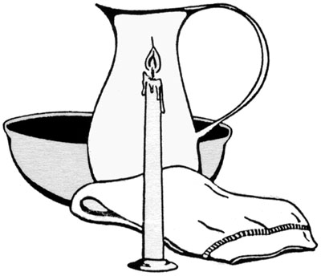
Diaconal Ministry Working Group

Slide 2
Diaconal Ministry Working Group
The Working Group mandated by the Permanent Committee on Ministry and Employment Polices and Services (based on GC Proposal 2009) to:
  report on the historic and current practice of diaconal ministry in the United Church
  consult with Diaconal Ministers and DUCC: determine mechanism to support and encourage diaconal ministry
  make recommendations related to the future directions for diaconal ministry within the United Church.

Slide 3
Diaconal Ministry Working Group
Process
Working Group Conversation
Consultation with DUCC
Review of DM history and relevant reports
Survey: OM, DM, DLM, Lay Members
Draft Report to PC-MEPS
Consultation with DUCC
Final Report to PC-MEPS

Slide 4
Diaconal Ministry Working Group
From consultations and review …
Diaconal Ministers: understood to be commissioned to functions of education, service, and pastoral care.
However, the current and future role of Diaconal Ministers needs to be understood as more than function.
Diaconal Ministry is characterized also by identity and perspective.

Slide 5
Diaconal Ministry Working Group
Commitment to Justice
Valuing Diversity
Rooted in Community
Teaming and Mutuality
Pioneers; Innovation
Identity and
Perspective

Slide 6
Diaconal Ministry Working Group
Survey Responses:
Ordained - 358
Diaconal - 136 (73% working, 27% retired or not working)
DLM - 34
Candidates - 40
Lay Members - 87

Slide 7
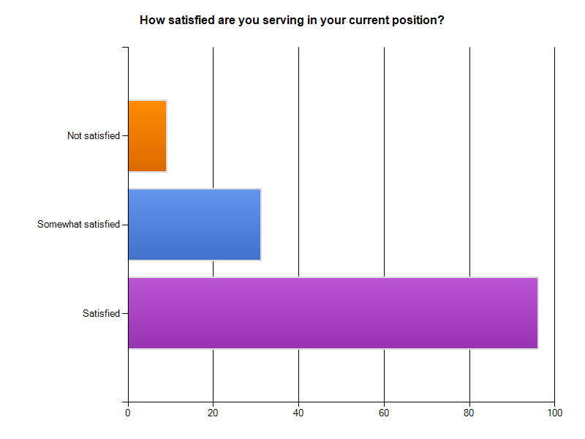
Diaconal Ministry Working Group

Slide 8
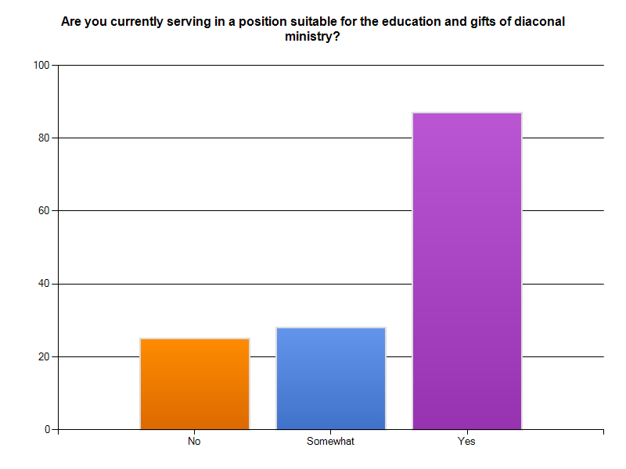
Diaconal Ministry Working Group

Slide 9
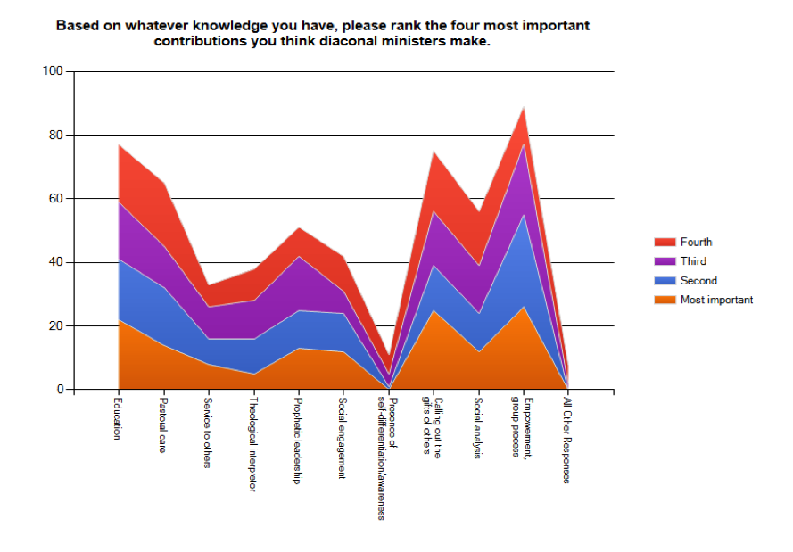
Diaconal Ministry Working Group
How diaconal ministers see themselves

Slide 10
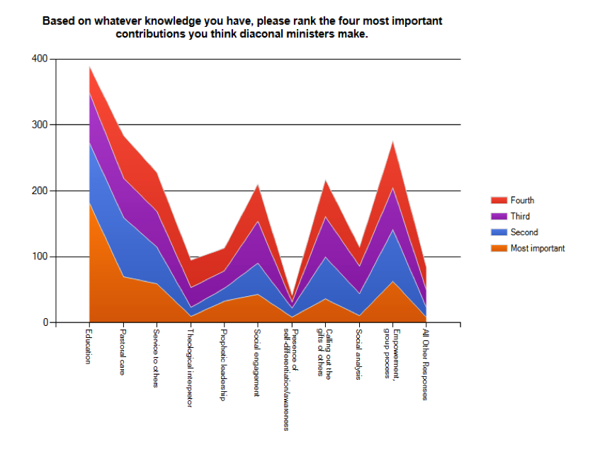
Diaconal Ministry Working Group
How diaconal ministers are seen by others

Slide 11
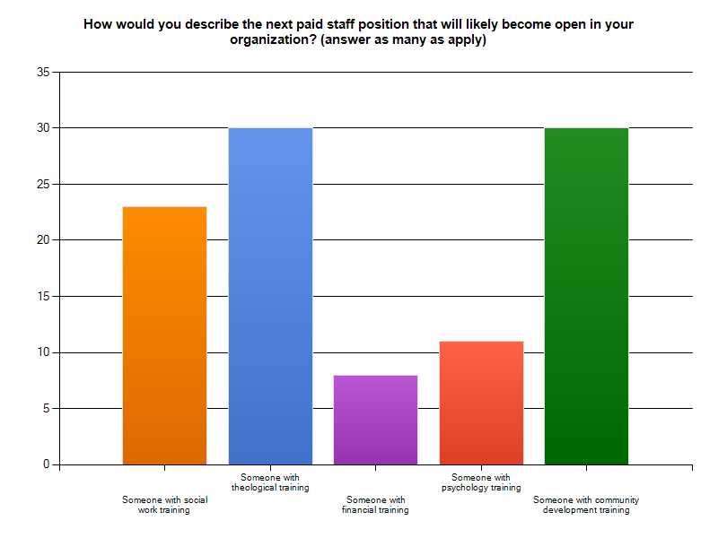
Diaconal Ministry Working Group
Question to community ministry respondents:

Slide 12
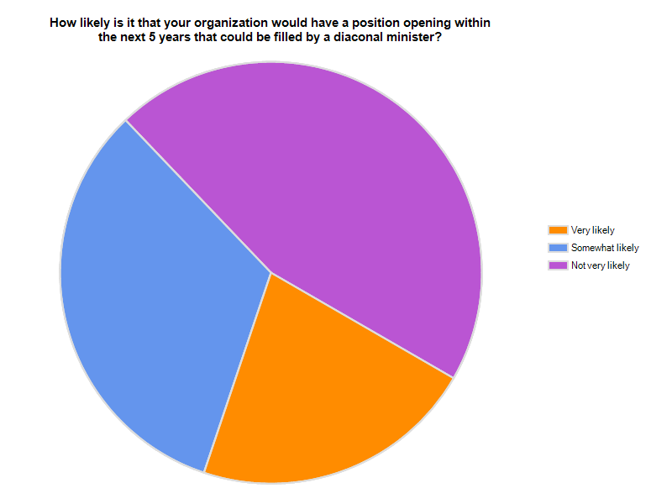
Diaconal Ministry Working Group
Question to community ministry respondents:

Slide 13
Diaconal Ministry Working Group
Observations:
Diaconal Ministers understand their gifts of ministry differently than how others see them.
While high level of job satisfaction by Diaconal Ministers also concern about the way Diaconal Ministers are valued.
Diaconal Ministers are especially, although not uniquely, prepared to provide leadership to the emerging church.
Discernment Committees and Education and Students Committees there is commonly a lack of knowledge about Diaconal Ministry

Slide 14
Diaconal Ministry Working Group
Recommendations:
policies and procedures relating to granting sacramental license should be consistent and equitable across the church
Expand Presbytery-Recognized Ministry to include positions where the supporting agency is not in a covenanted relationship with a presbytery
The M&E Unit ensure that the Program Coordinator for Recruitment is knowledgeable about Diaconal Ministry
Ensure resources for recruitment and discernment include information about Diaconal Ministry and creating diaconal positions with Presbytery Recognized Ministries.

Slide 15
Diaconal Ministry Working Group
Recommendations (con’t)
Track whether Diaconal Ministers are finding positions in non-pastoral charge roles now that settlement is no longer mandatory
The M&E Unit review pastoral relations resource documents to ensure that those engaged in pastoral relations are aware of options related to Diaconal Ministry.
That PC MEPS explore the possibility of implementing a program which will provide a stipend or wage during their field placement for Candidates from the Centre for Christian Studies and the Sandy-Saulteaux Spiritual Centre

